Slide 1
Why I Do What I Do.
Olanrewaju Oladimeji

Slide 2
AGENDA
What do I do?
Why do I matter?
What is my impact?
What’s in it for you?

Slide 3
What Do I Do?
I AM A PROBLEM SOLVER.

Slide 4
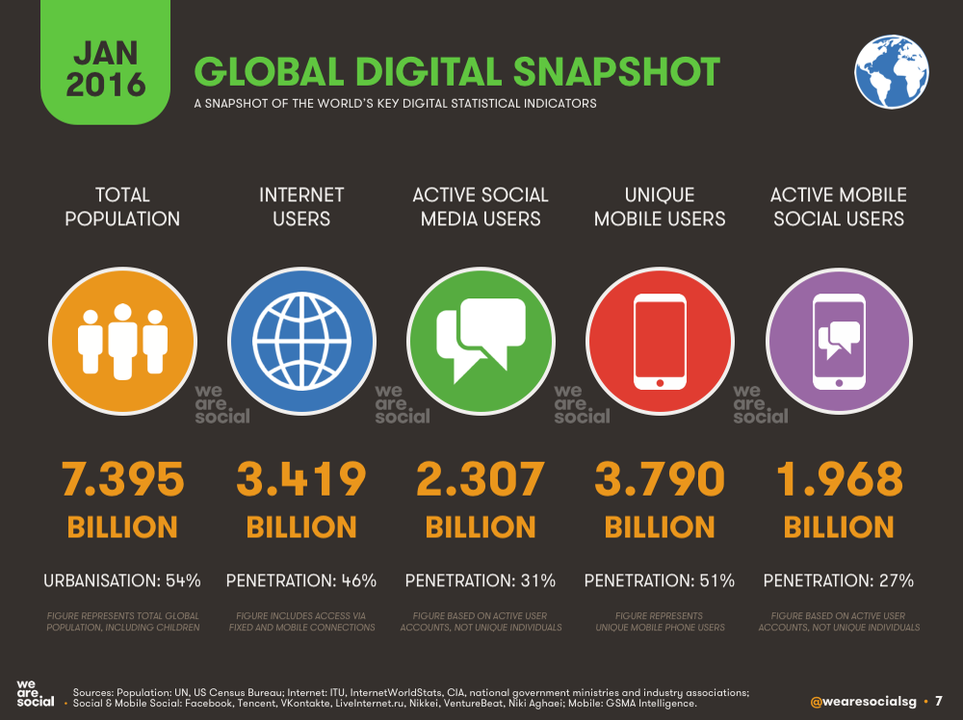

Slide 5
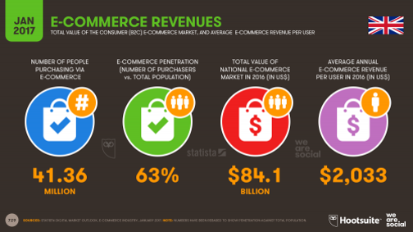

Slide 6
What is the problem?
01
Traditional Marketing has become so expensive and business owners are constantly seeking new ways to get traction for their business
02
It is absolutely impossible to track the efficiency and results of traditional marketing.
03
The world has become a digital village and it would be extremely foolish to ignore the rising tide in digital users. The only wise thing would be to tap into those numbers.

Slide 7
THIS IS WHERE I COME IN.

Slide 8


Slide 9
With the unfolding of modern technologies and preponderance of Digital Marketing (DM), businesses are doing all that they can to match up the pace. Businesses are either changing their plans of action into the digital one, or amplifying existing marketing strategies with digital advertising techniques-

Slide 10
What do I do?
I am a digital marketer and I have the very interesting task of taking businesses from 0 to 100 using the Internet as my playground.

Slide 11
Why Do I Matter?
01
72% of marketers believed that traditional marketing was no longer sufficient and Digital Marketing would make their company revenue to be increased by 30% by the end of 2017
02
More than 80% of businesses will increase their digital marketing spending plan that may go beyond the IT budget.
03
34% of the businesses already had an integrated digital marketing plan in 2016

Slide 12
What does this mean?
I AM IN DEMAND!

Slide 13

WHAT IS MY IMPACT?

Slide 14


Slide 15
WHAT’S IN IT FOR YOU?

Slide 16
Job Prospects in Nigeria
Digital Marketing Manager
Content Marketing Manager
Search Engine Marketer
Social Media Marketing Manager
Copywriting expert
Online Reputation Management

Slide 17
The Only Way to Acquire These Skills
LEARN, UNLEARN AND RELEARN!

Slide 18
WHEN IT ALL COMES DOWN TO IT, NOTHING TRUMPS EXECUTION – Gary Vaynerchuk

Slide 19

Thank you!

